Slide 1

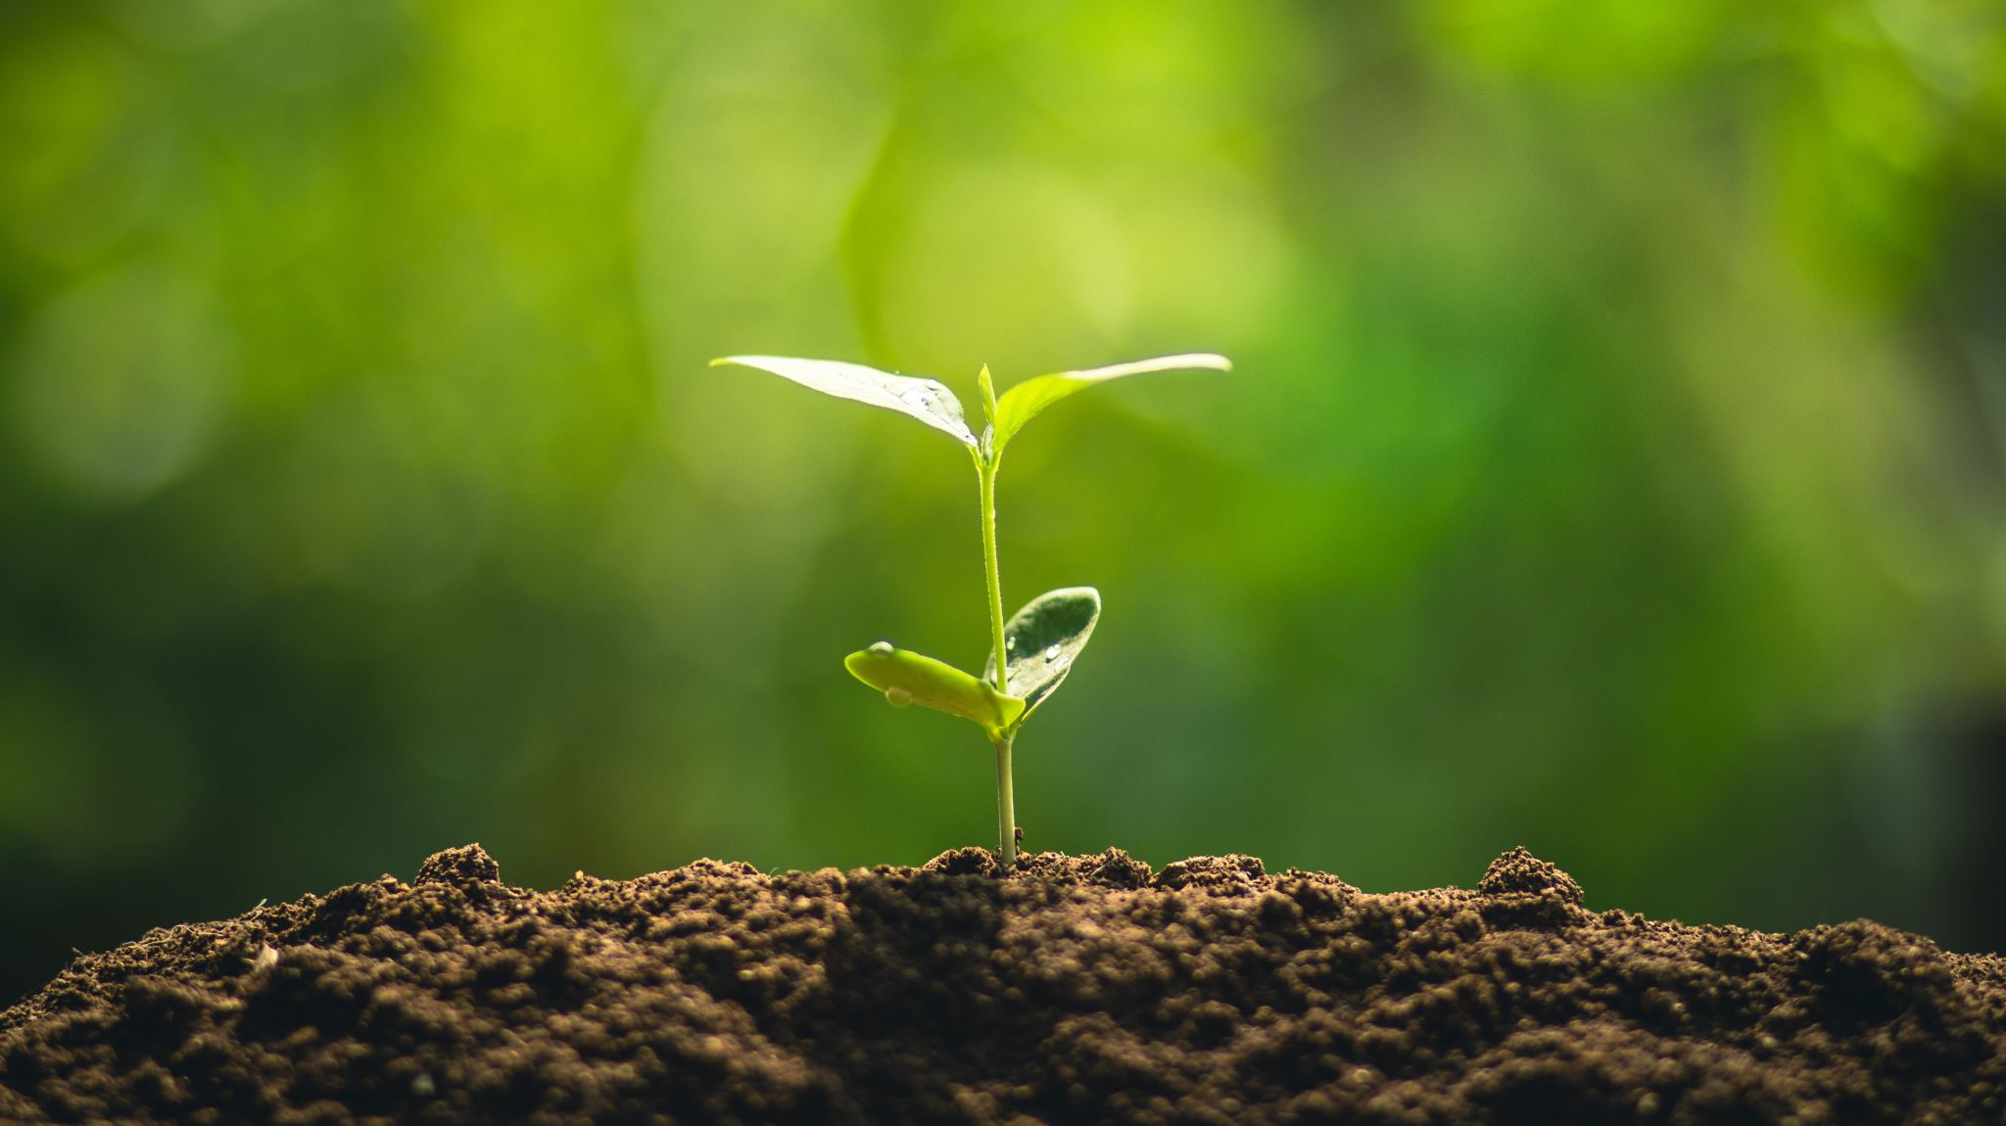

Smart Farming
Developed By
Tech Farm
Connecting the unconnected
Prepared By:
Abhisha Bhesaniya
Simran Padaniya
Vijay Patel

Slide 2
Outline:
Background Information
Problem
Block diagram
Flowchart
Working prototype
Solution
Project Description
Contact information
Challenges
Assumptions
Technologies and Software used
What Product will do

Slide 3
Background information
As per the reports, Canada is having a larger but fewer farm (statics Canada, Census of Agriculture). Thus, it becomes difficult to look after such big land. Smart Farming will help farmers to do their work with less workload.
There may be many companies working on the same concept, but sensors are not sending data to data base. What make us stand out is the thing that we are trying to make it less cheap.
The difference will be features that will depends on customer’s need.
So, after completing of our basic model we would like to add some extra features like sending alert messages, showing weather forecast, remote control using application, livestock monitoring, etc.,

Slide 4
Problem
Data is not being stored for future reference
Sensors are not IoT based
People are not using Technology effectively

Slide 5
Solution
Control the system without any user intervention.
Provide real time data to its users.
Save data for future uses
Increase the productivity and quality of crops
Save water and power

Slide 6
Project Description
Tech farm is a Wi-Fi based product that helps farmers to remotely monitor the soil moisture, temperature &humidity and control the amount of water delivered to crops without any manual intervention.
Tech farm will maintain logs it will send all the data sensed by the sensor in to data base with all the required details
The system will allow the user to access the data from the database for their analyses using a API Rest client application.
Basically it will keep an eye on level of soil moisture once it will go above threshold value it will turn on the Pump and once it will reach threshold value it will turn off the pump.

Slide 7
Assumption
Wi-Fi network
Desktop setup for Raspberry pi
A compatible Smartphone with a data plan
Water Source
Power supply

Slide 8
What Product will Do
Remote monitoring of soil moisture, temperature & humidity.
Remote control of the water pump
Log all the information for future
Easy maintenance
Economical

Slide 9
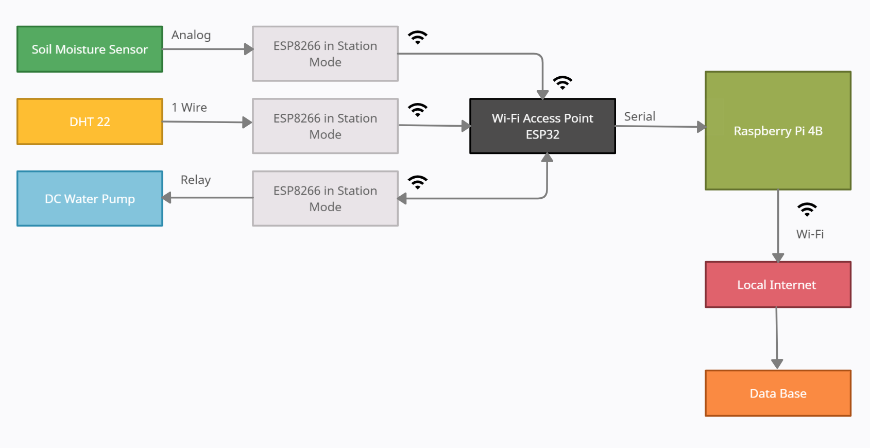
Block Diagram

Slide 10
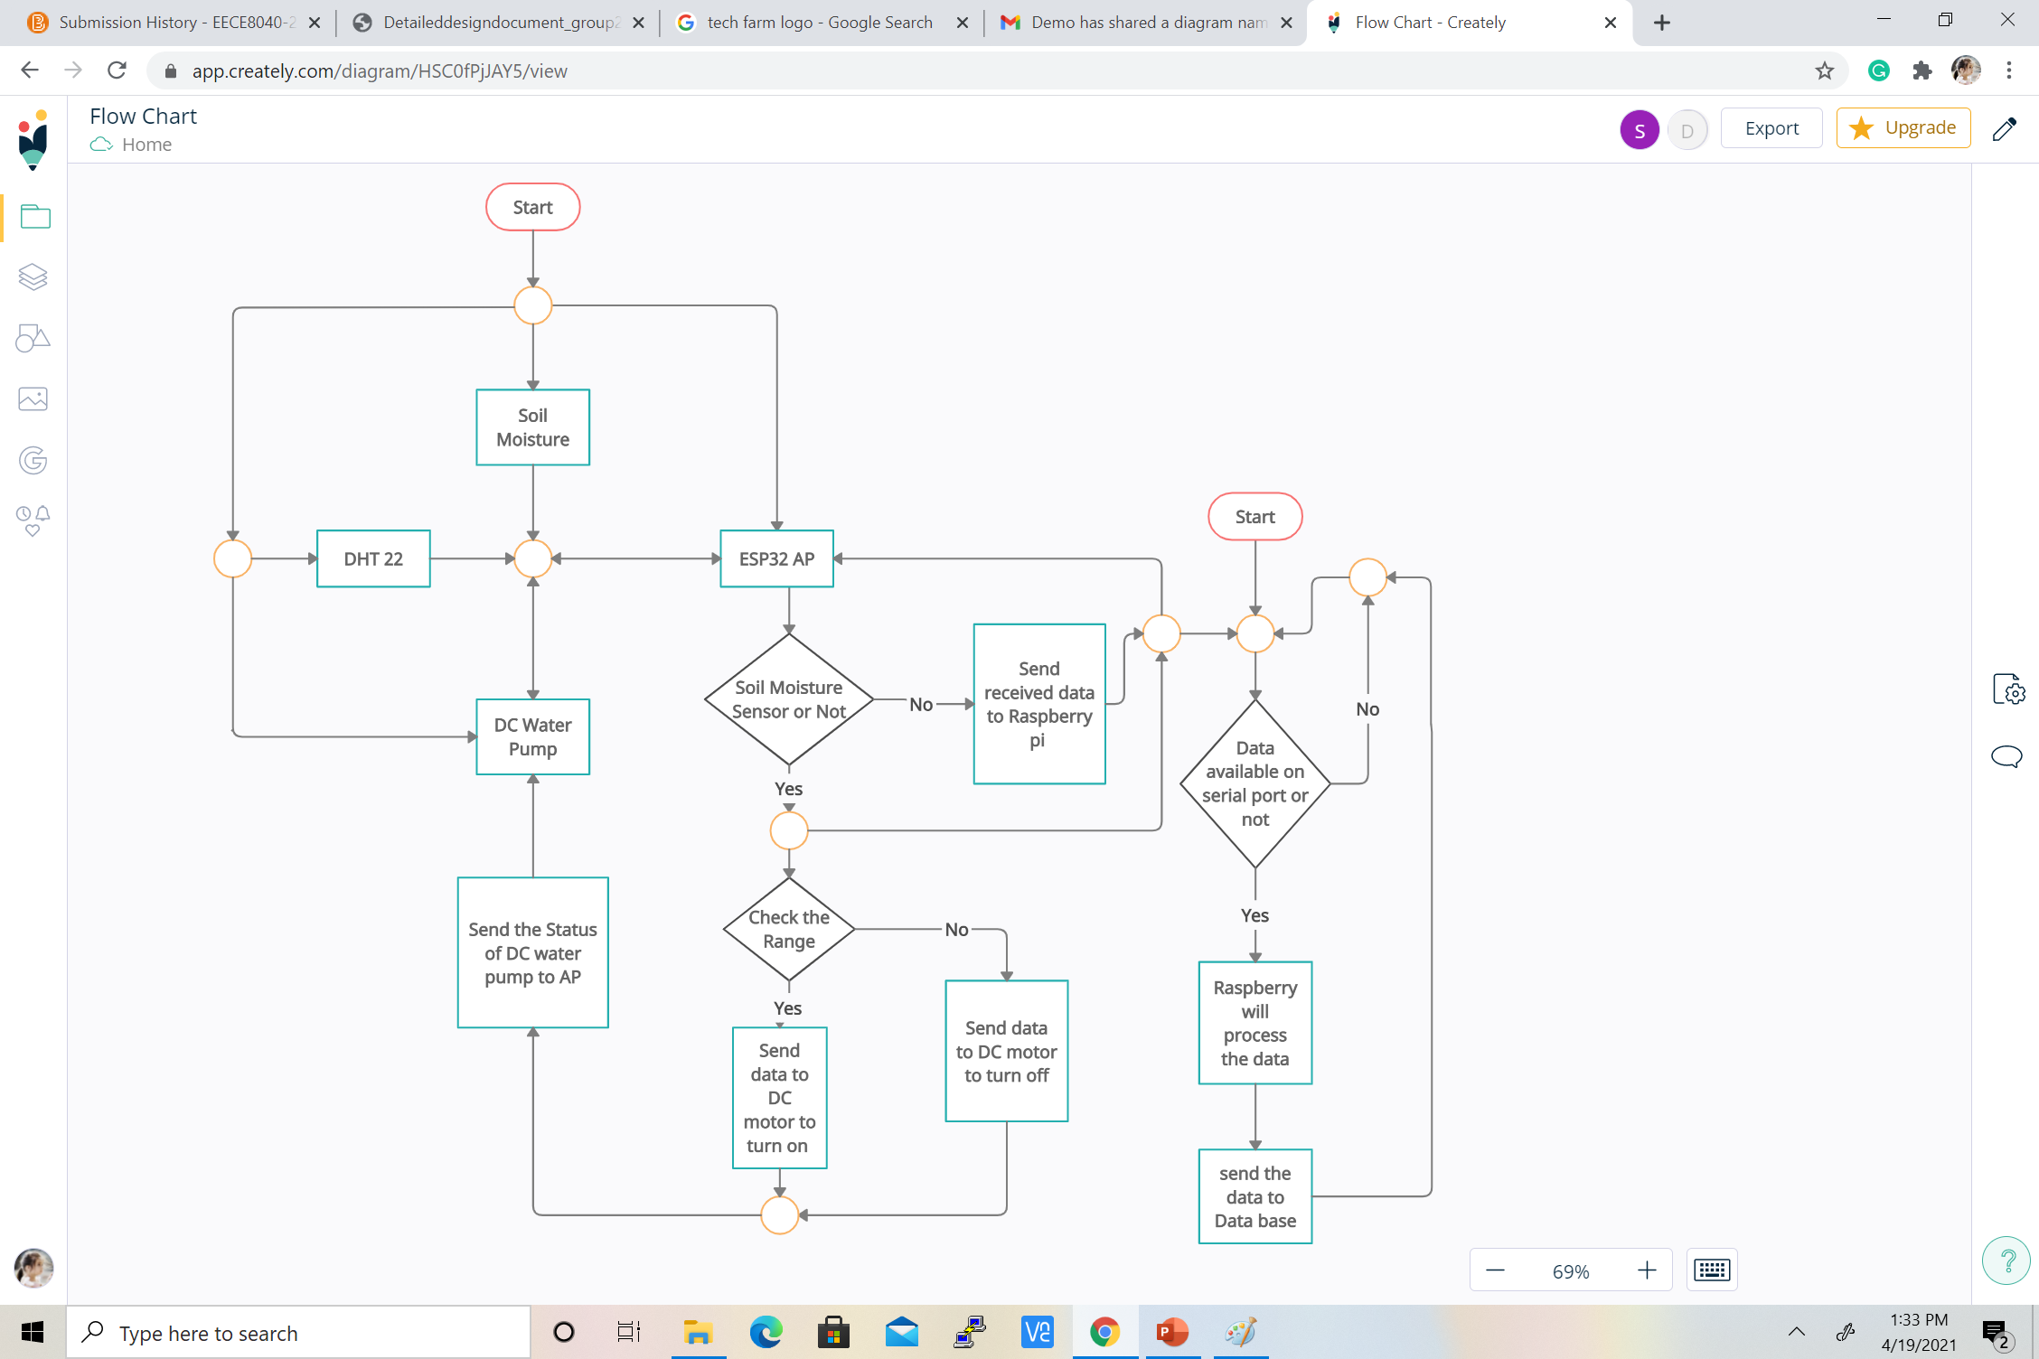
Flow Chart

Slide 11
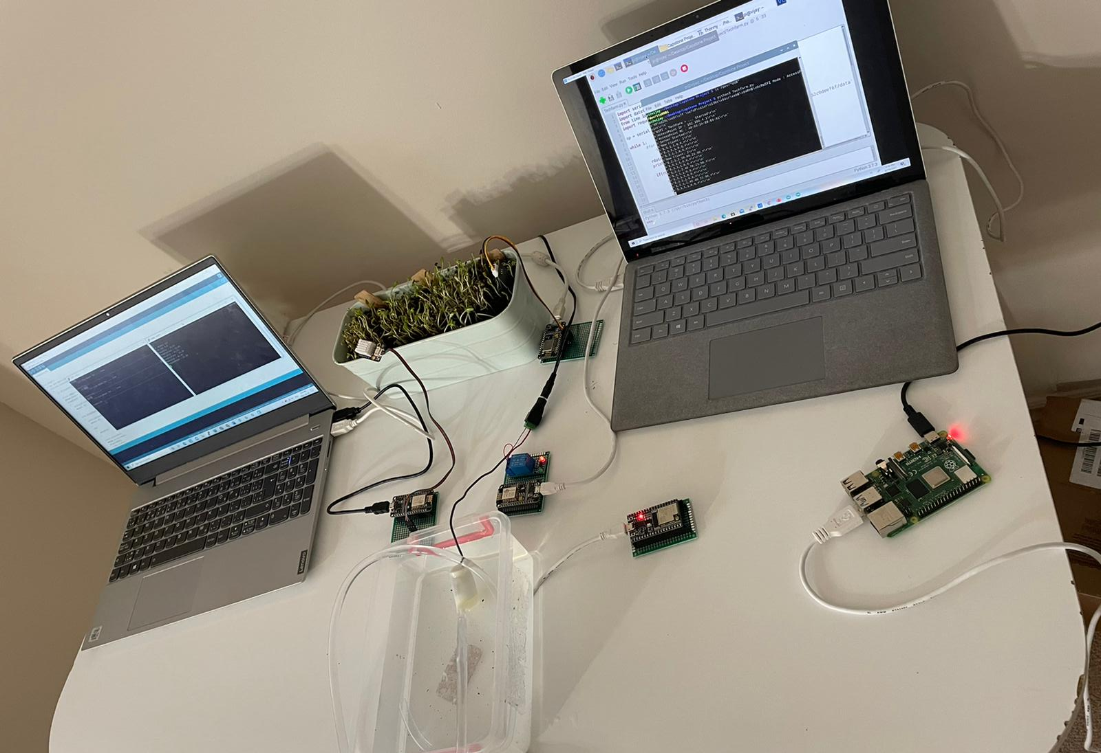
Working Prototype

Slide 12
Technologies & Software Used
C/C++
Python
Wi-Fi
REST Api
MongoDB
Raspberry pi4
ESP 8266 & ESP32
Soil moisture sensor
DHT22
DC Water Pump
VNC viewer
Arduino IDE

Slide 13
Challenges
Biggest challenge is to make the system reliable to work in any environment condition for year without the user. It should be able to auto correct any failures.
01
Reliability
Software is to be safe from viruses and malwares.
Data Security
02
Security
The system should be very easy to maintain
03
Maintenance
The cost of the product must be such that user can afford it.
04
Affordability

Slide 14
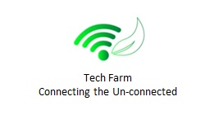
Contact Information
Get in touch with team
At
info@techfarm.ca

Slide 15
Question ?

Slide 16

Thank you !!!

